Slide 1
العرض الالمع للخدمات التجارية
Shinest Show for Commercial Services

Slide 2
About Company
Shinest Show is a new established provider of LED display solutions covering indoor, outdoor, and rental applications along with audio-video systems and smart systems. Shinest show aims to provide high-quality, reliable products with best-in-class price performance. Our displays cover a wide range of applications including Commercial Display, Data Visualization, Rental, Staging, and DOOH, so whatever your vision or need there's an LED solution scaled, designed, and priced to fit you through constant innovation and development along with other regular advertising services

Slide 3
Our Vision :
Maintain integrity and lead the industry. Build a commercial civilization that promotes honesty, high quality, responsibility, and mutual success! We run our business with sincerity and integrity, seeking to develop better to lead the industry and light up the world. We are determined to build a business civilization that promotes honesty, high quality, responsibility, and mutual success.

Slide 4
Our Mission :
Providing products with high standards of quality.
Building a wide base of customers, whether from the public, companies, or government sectors.
Using the finest marketing methods and innovations in the economic movement. Establishing a good reputation for the institution among its customers.
Build a long-term relationship with customers.
Providing high-quality services and correct technical consultation.

Slide 5
KEY PRODUCTS AND SERVICES
LED DIGITAL
OUTDOOR
Displays
SOLAR
3D
displays
INDOOR
DISPLAYS
ROADS
SAFTY

Slide 6
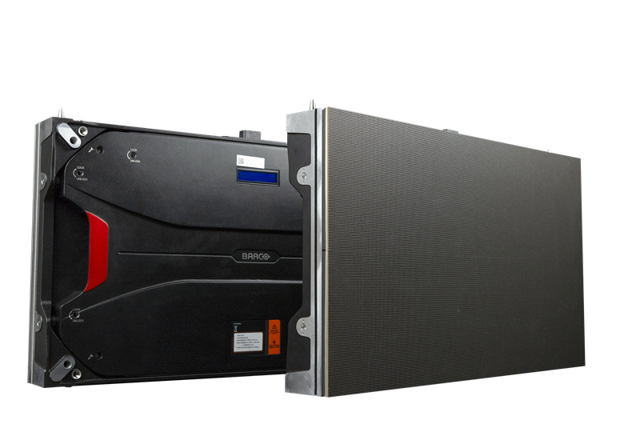
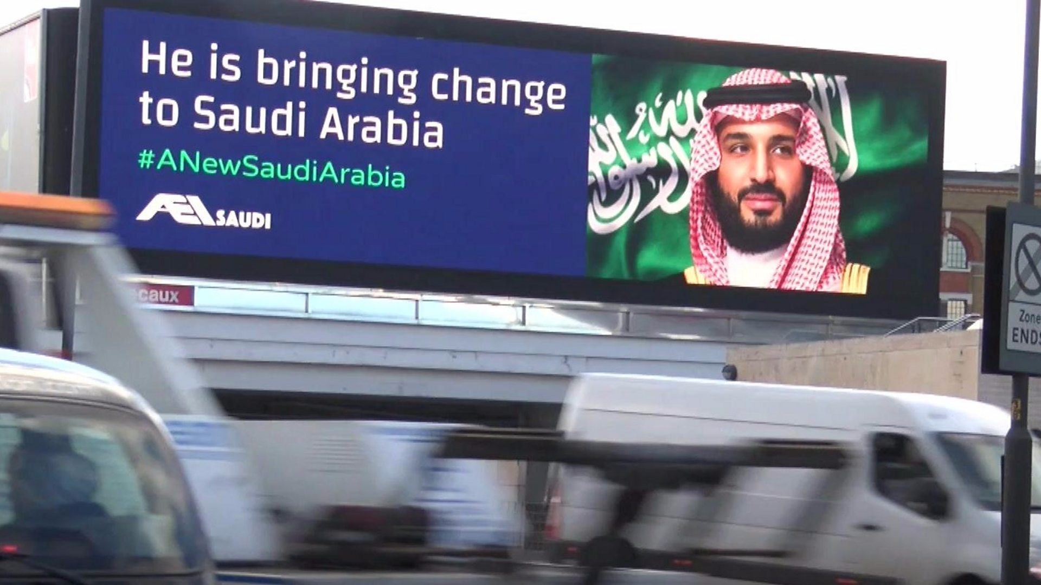
External , Internal ( LED Screen Display ) :
Supply ,Install ,Rental external ,internal LED SCREEN DISPLAY sizes : ( P6 ,P5 ,P4 ,P3 ,P2.5 ,P2 ).

Slide 7
Outdoor Screens
External advertising screens are one of the best types of advertising screens that are used in the field of advertising, in addition to their ability to display advertising in all ways, whether in writing or through videos or images. The biggest advantage of the LED screen is that it is highly efficient and effective in ensuring To deliver your advertising message to the audience with a high resolution.

Slide 8
Outdoor Screens
Ultra slim
Bright and Vivid
Water/Dust Proof
High Refresh Rate
Features and Benefits
Excellent Heat Dissipation Capacity
Clear Resolution
Low Power Consumption
High Contrast Ratio

Slide 9
Indoor Screens
Installed to cover the required space by square meter. It can be used for Exhibitions, conferences, wedding halls, and Events for excellent display Resolution.

Slide 10
Indoor Screens
Extreme Close Viewing Distance
Crystal-Clear Image
Advanced Video Processing
Smooth Motion
Features and Benefits
Uniform Display Picture
High Resolution
Versatile Pixel pitch Selection
Colorful Graphics

Slide 11
Led Rental Screens
Rental LED display has a light and thin structure. It has high stability and is easy to install and disassemble at any time.

Slide 12
Mobile Advertising Trucks

Slide 13
Exhibitions

Slide 14
Theaters

Slide 15
Smart Meeting Room
A smart meeting room is a key element of a smart office setup. Smart meeting rooms are powered by intelligent technology that integrates hardware and software tools into the meeting space to create a highly productive meeting experience for remote and in-person attendees.

Slide 16
Smart Office
Smart offices use technology to increase productivity and collaboration. Smart office automation and technology also improve the working environment through energy efficiency, enhanced security, and streamlining processes.

Slide 17
Smart Home
A smart home allows homeowners to control appliances, thermostats, lights, and other devices remotely using a smartphone or tablet through an internet connection. Smart homes can be set up through wireless or hardwired systems. Smart home technology provides homeowners with convenience and cost savings.

Slide 18
Audio System

Slide 19
Video Conference

Slide 20
Conference Rooms
For conference calls, board meetings, management discussions, and other major decision-making situations.

Slide 21
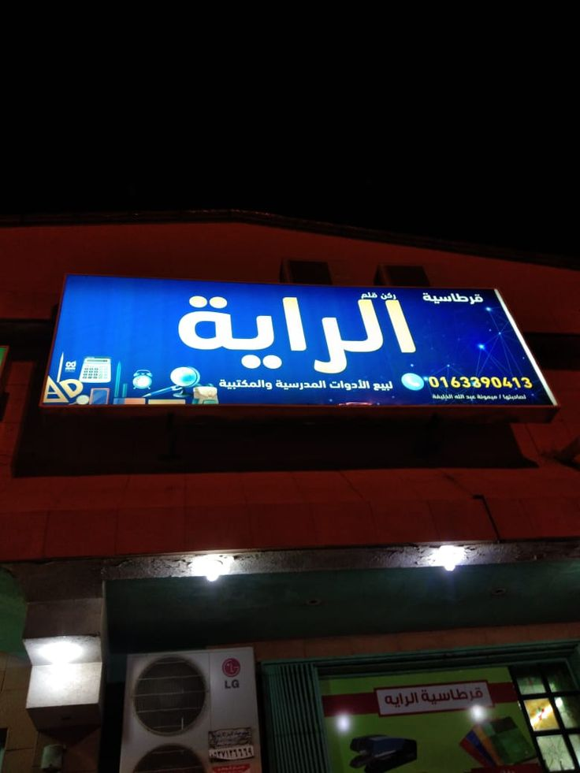
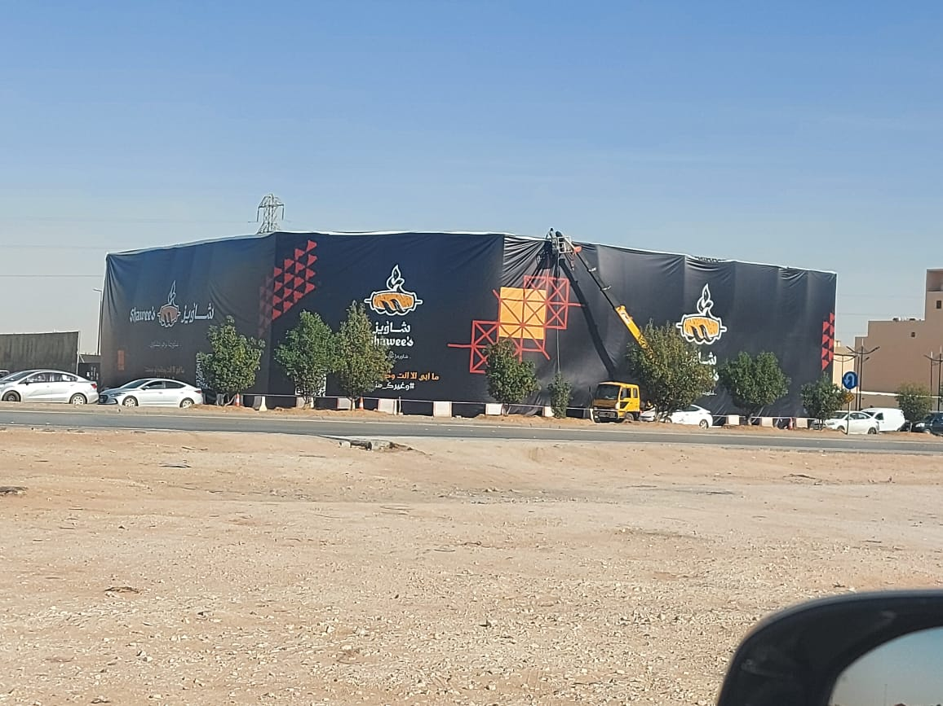
Vinyl , Pannier and Flex:
It was necessary to keep pace with the rapid development of the advertising industry, so IBDAA is proud to offer its valued customers vinyl and banner printing services using the best specialized technology for that.

Slide 22
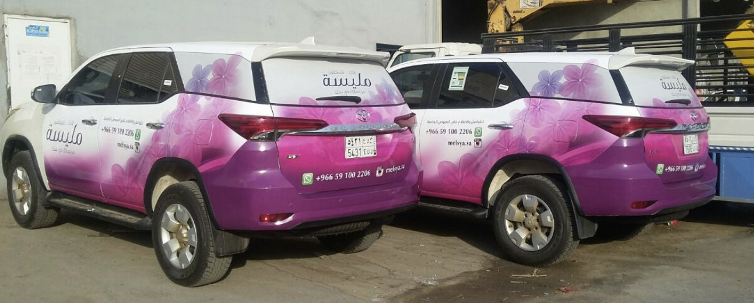
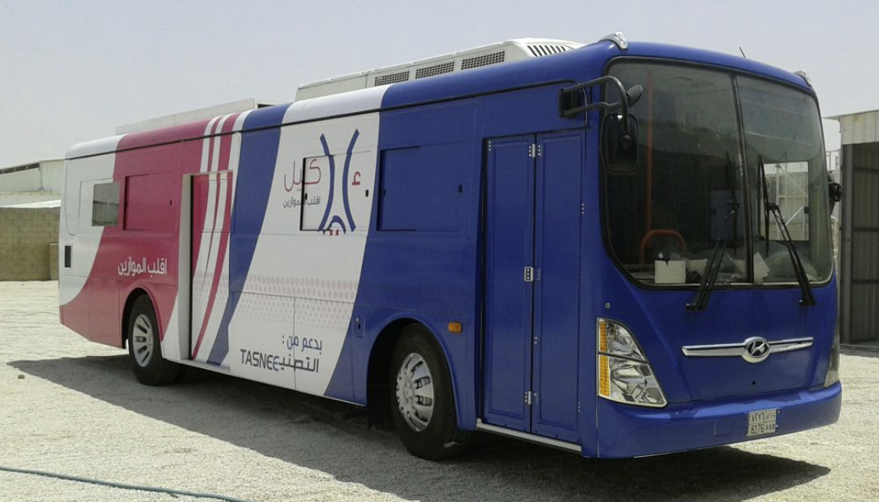
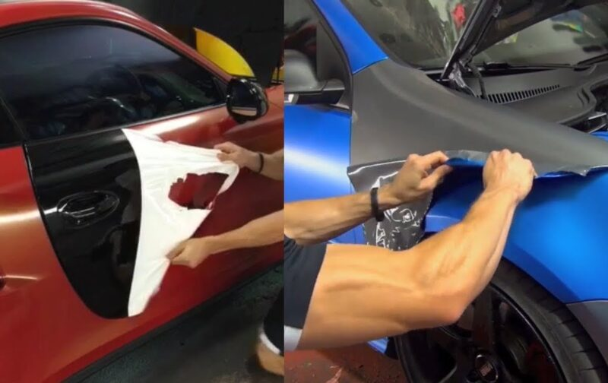
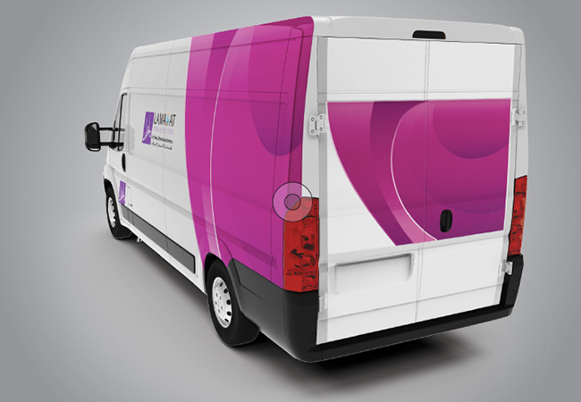

Slide 23
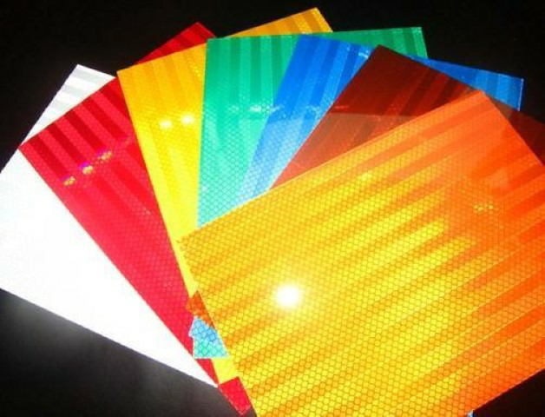
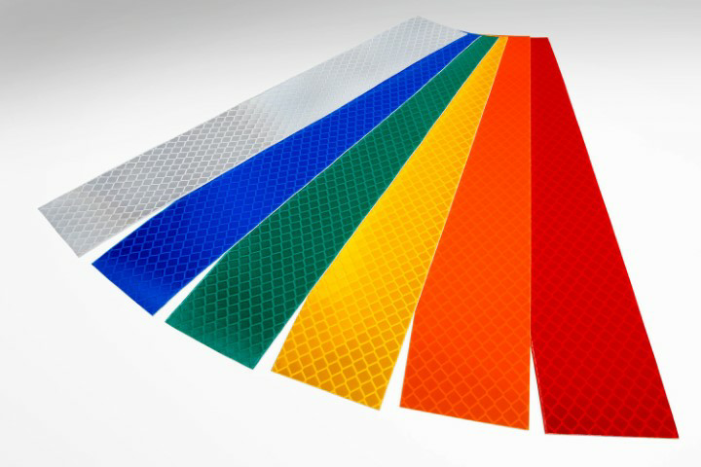
Reflective Sticker:
Reflective films are laminates with high prismatic reflectivity of light by fine glass granules embedded in reflective films during manufacture. It has the ability to reflect lighting from several angles. It is used on flat panels to reflect the lighting of vehicles and clarify the content to be clarified .

Slide 24
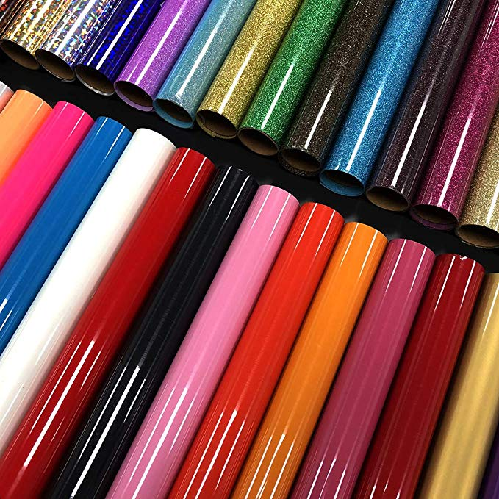

Slide 25
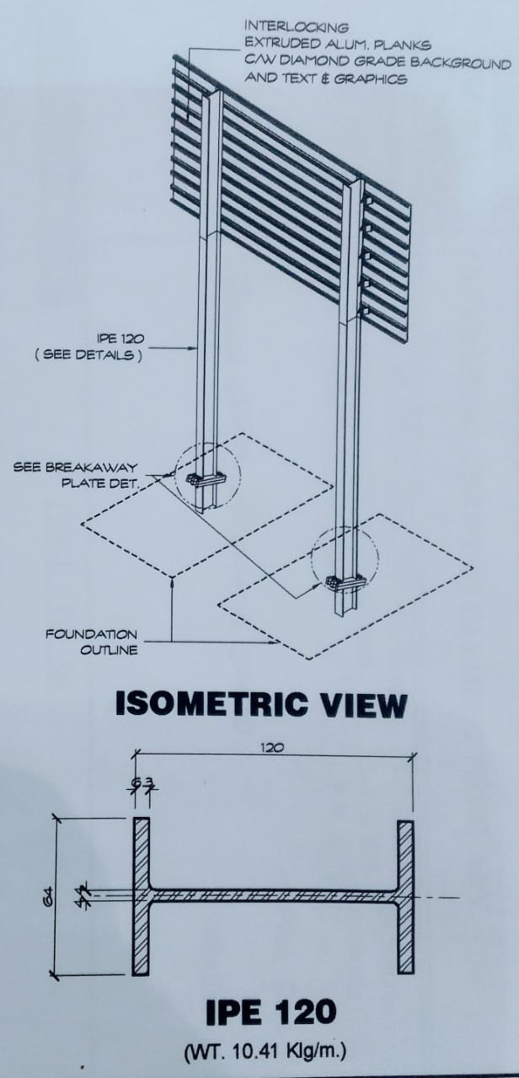
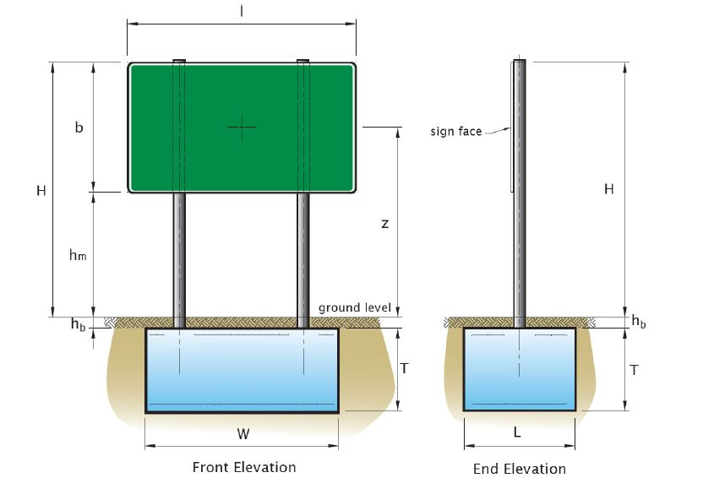
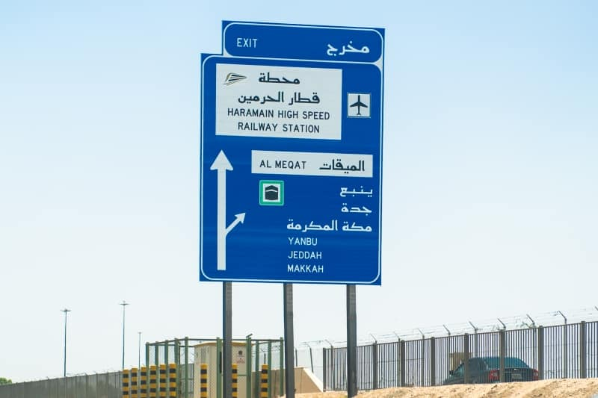
The Columns of the guiding boards:
Traffic signboard poles are made of galvanized I-beam poles, according to the Ministry of Transportation.

Slide 26
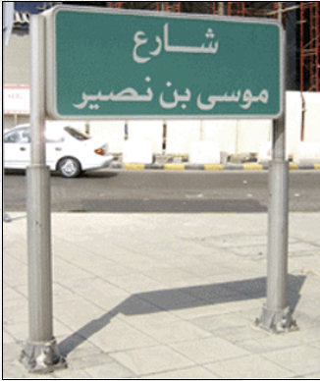
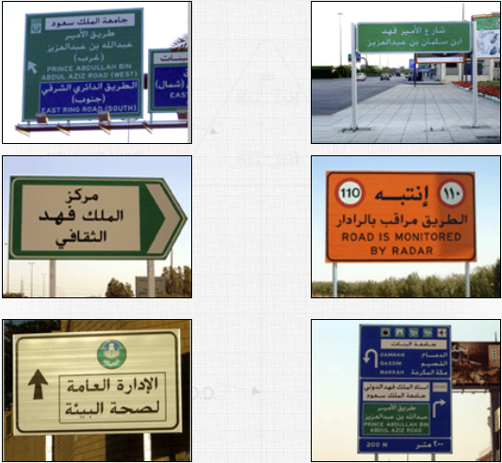
Traffic Signs
Traffic signs are manufactured from aluminum extruded blanks width 20 CM. and thickness 2 mm. or by aluminum boards thickness 3 mm. with 3M reflective sticker.

Slide 27
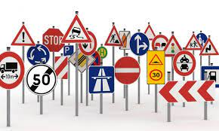
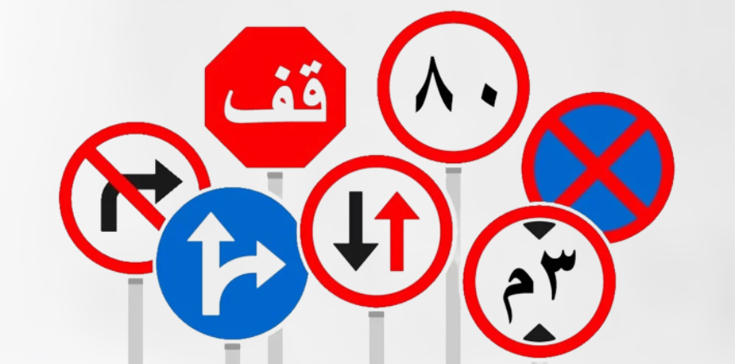
Warning, Regulatory , Informative & Working Zone Traffic Signs :
Standard traffic signs are manufactured from Aluminum sheets with 3 mm. thickness as the required Measurement ( 60 cm. & 75 cm. & 90 cm. ) covered with reflection sheets diamond degree ( DG3 ) yellow color to be used on Work areas and transfers.

Slide 28
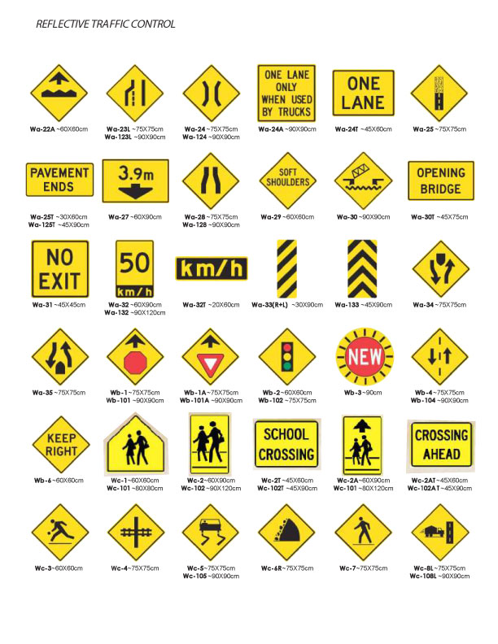
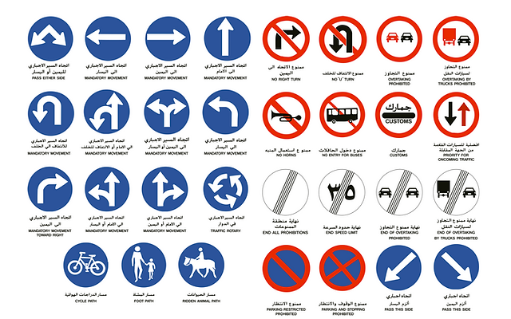

Slide 29
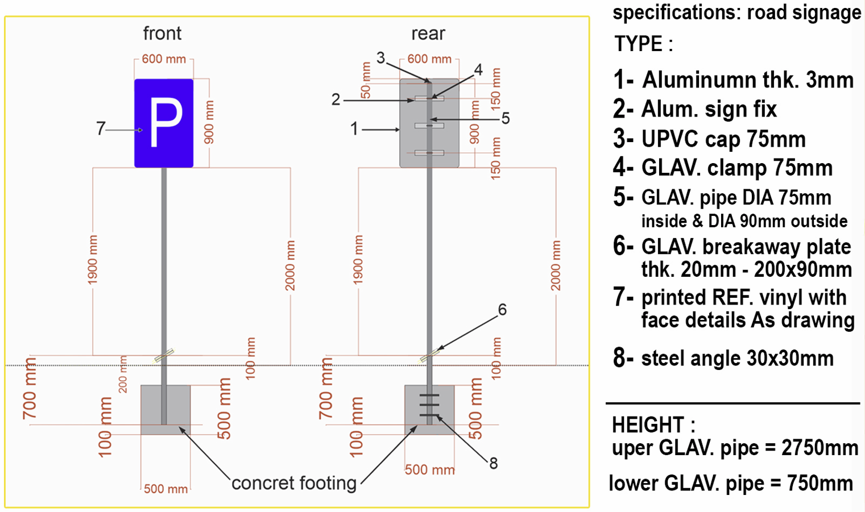
Standard traffic signs – PIPE POST :
Posts Standard Traffic Signs are manufactured from thermally GALVANIZED pipe post with outside diameter 76 mm. ( 2.5 inches ) OR 89 mm. ( 3 inches ). Thickness with 2.9 mm. pipe post are connected with movable joint ( BREAK AWAY ) by using GALVANIZED .

Slide 30
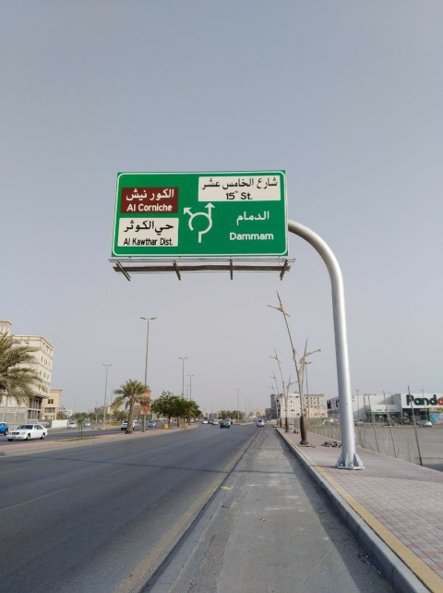
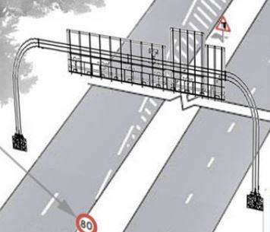
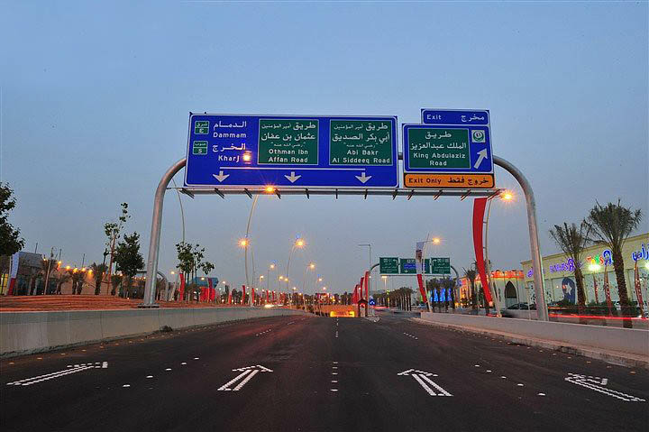
Gantries & Cantilevers Signs :
Gantries & Cantilevers Signs are manufactured with thermally galvanized pipe & flange DIA. 12 ,14 ,16 ,18 ,20 ,22 ,24 inches and steel structure of GALVANIZED by I beam 120 mm. & bracket thk. 15 mm. & aluminum profile size 20 cm & Reflective Sticker Of Printed .

Slide 31
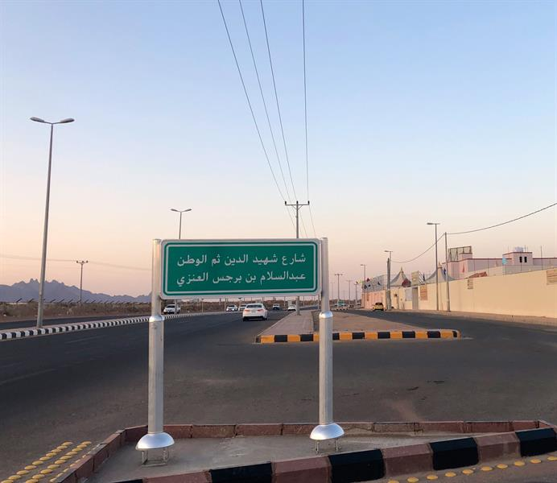
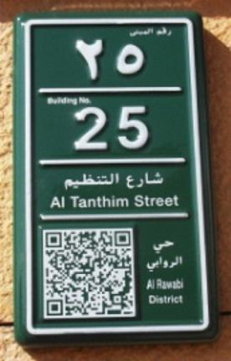
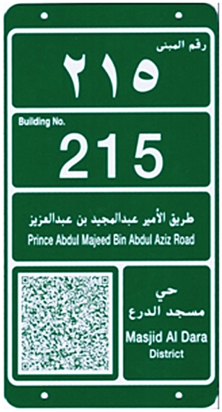
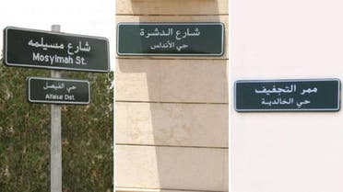
Street Naming and Numbering Sign Board :
The street name plates and property numbering are made of a PIPES of aluminum profile and a base of cast and thermally galvanized iron. The aluminum strip is folded into a rectangular shape, and aluminum plates have a thickness of 3 mm. A reflective sticker, 3 or printed, is affixed to it - the most important of these plates (island plates). The median for the names of streets, neighborhoods, street names) and property numbers are made of iron covered with thermal porcelain.

Slide 32
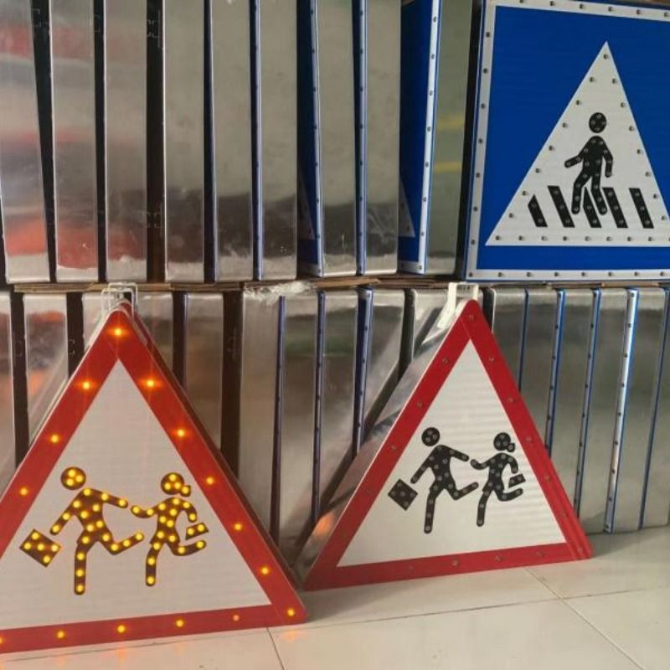
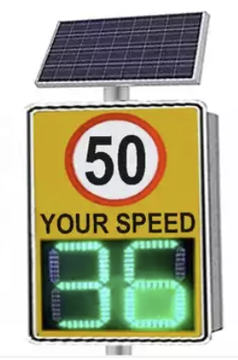
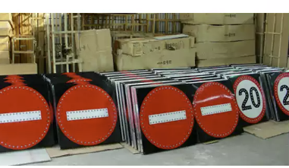
Solar or Electrical Traffic Signs :
Traffic Signs That Working With Electrical Or Solar Energy are Prepared With The Same Forms and Special Measurements Of All Types Of Standard Signs Provide With Solar Energy Screen ,Long –Term Battery ,LED and Sensor For LIGHTENING That Works Night and switches off day ,in addition To All Forms and Sizes Of Electrical Transformation Arrows and Progression Arrows .

Slide 33
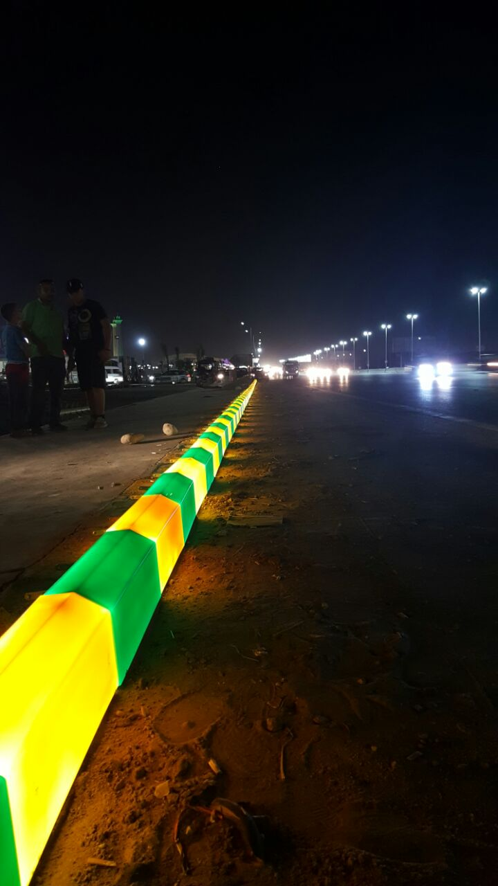
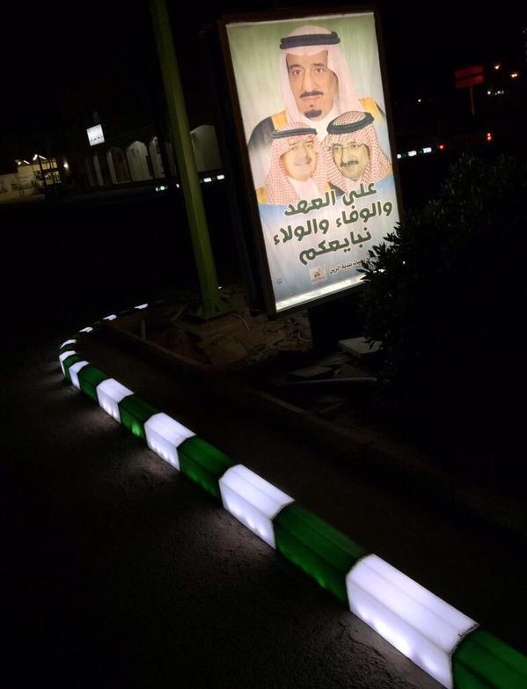
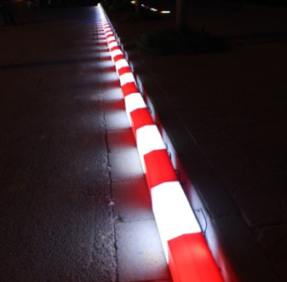
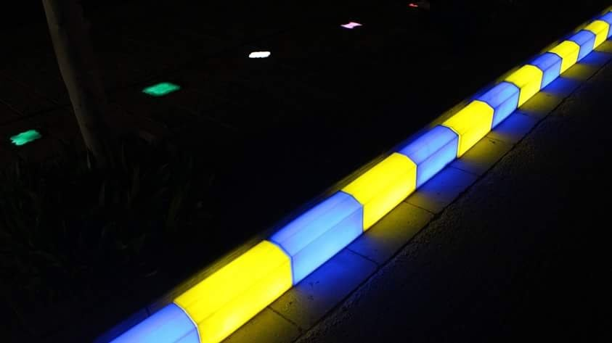
Solar and Electrical LED Lighting Curbs :
This LED light curb for finished plastic Curbstone with LED lighting by Solar or Electrical power Supply – This LED light Curb Creates a beautiful city road specially at night .

Slide 34
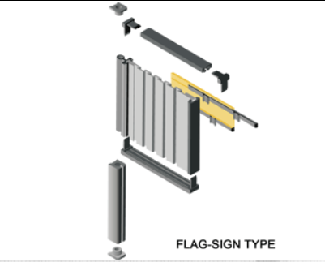
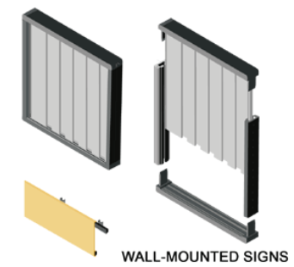
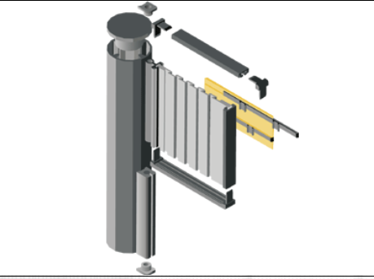
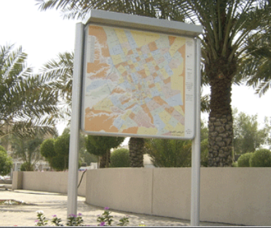
Internal and External panel systems :
The interior and exterior panels are made of aluminum in both types, wall and hanging, with different sizes and shapes, as required .

Slide 35
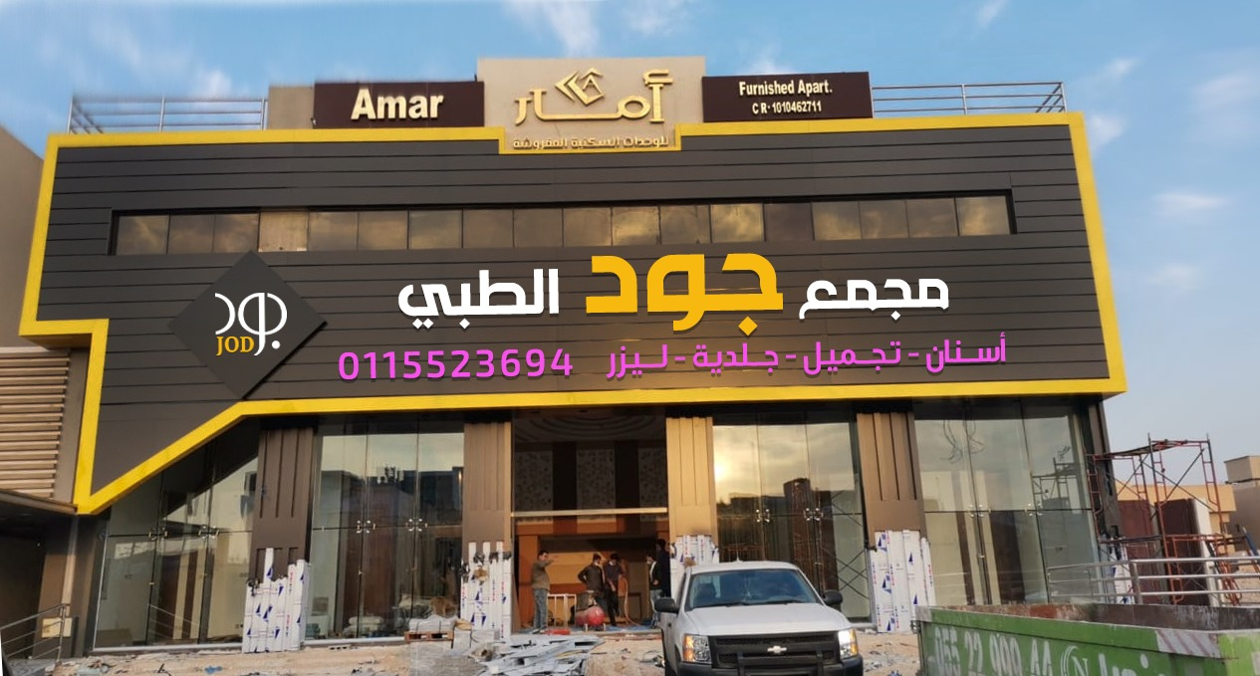
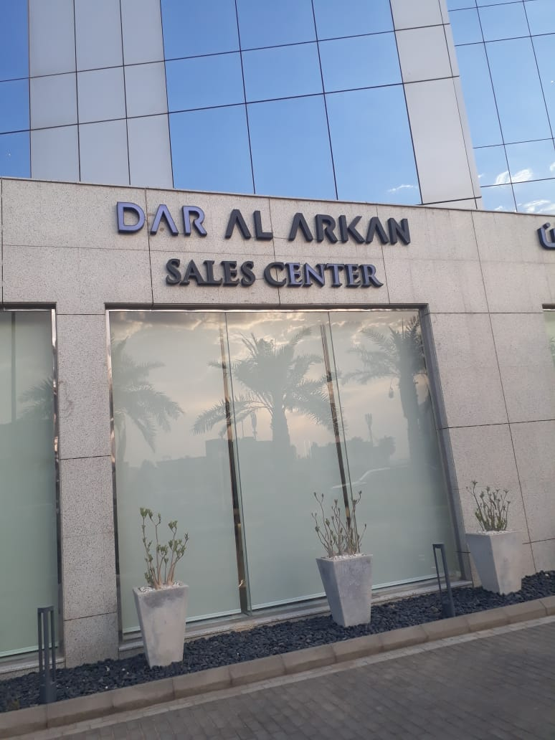
3D External & Internal Signages ( Front or Back Lighting ) :
Gantries & Cantilevers Signs are manufactured with thermally galvanized pipe & flange DIA. 12 ,14 ,16 ,18 ,20 ,22 ,24 inches and steel structure of GALVANIZED by I beam 120 mm. & bracket thk. 15 mm. & aluminum profile size 20 cm & Reflective Sticker Of Printed .

Slide 36
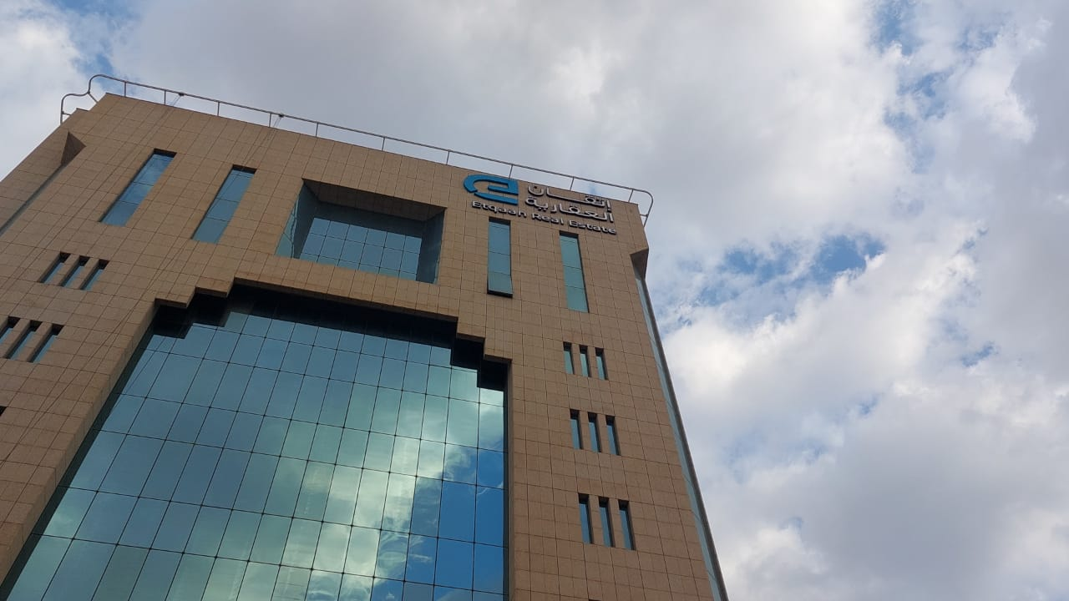
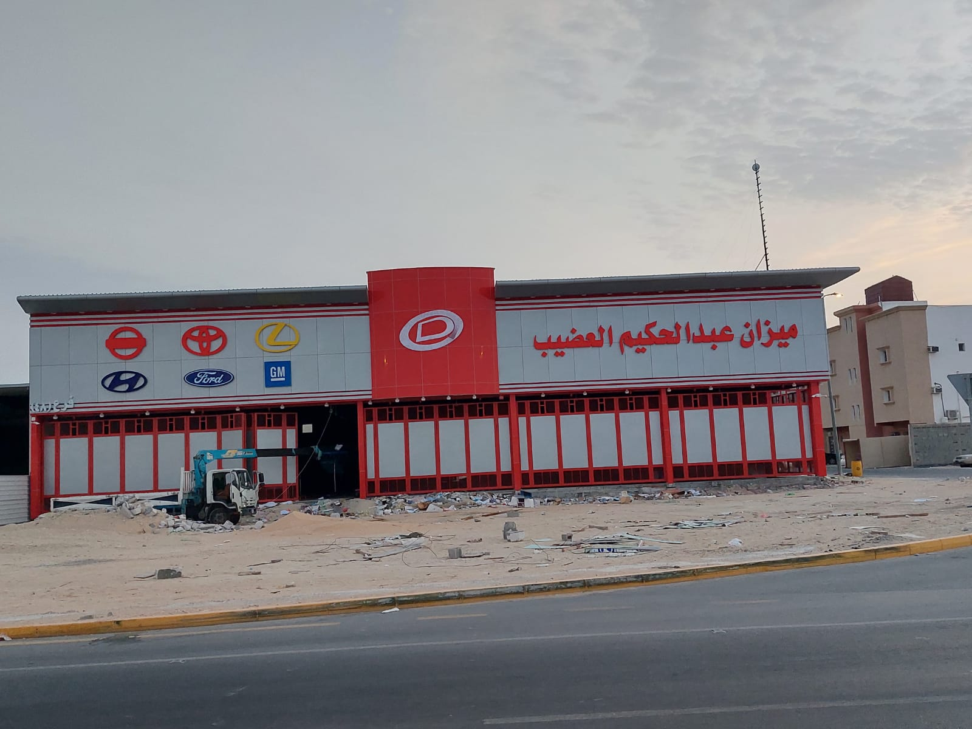

Slide 37
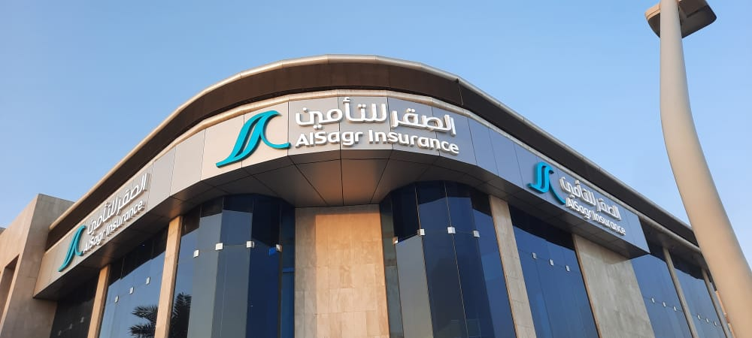
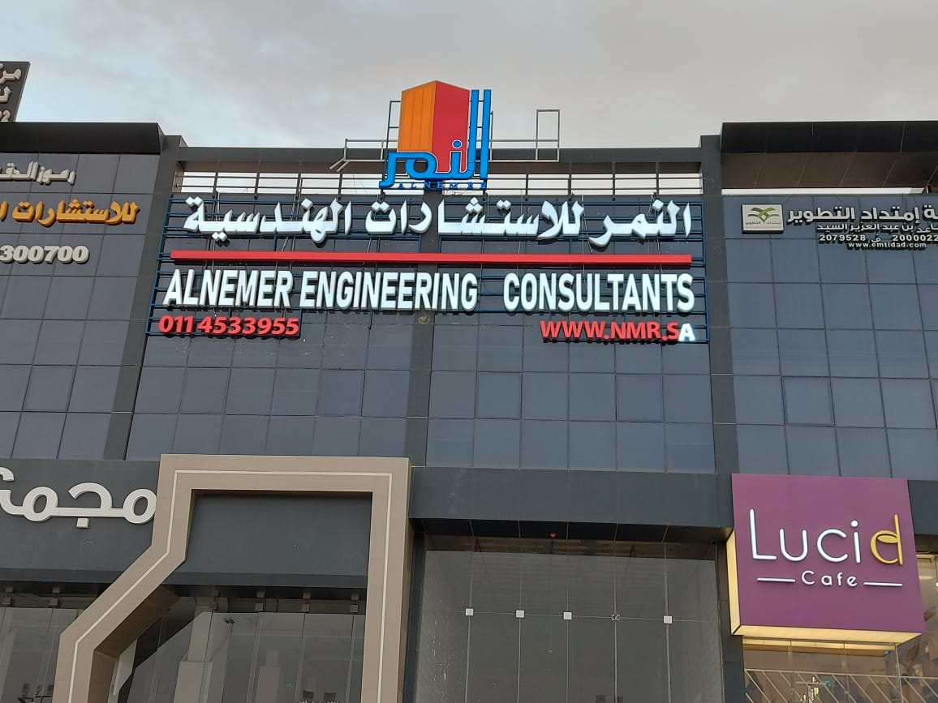

Slide 38
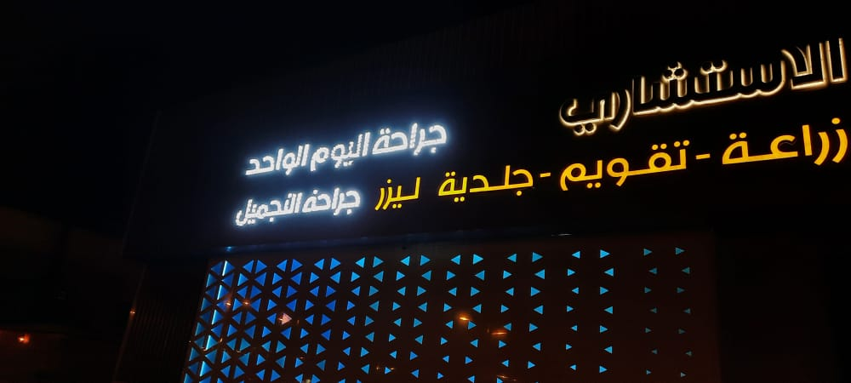
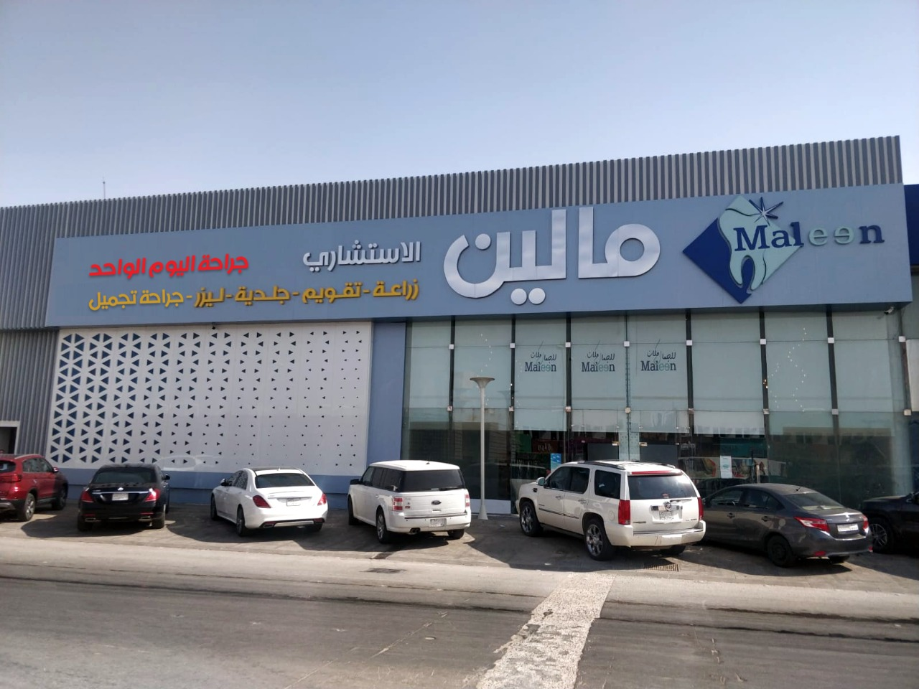

Slide 39
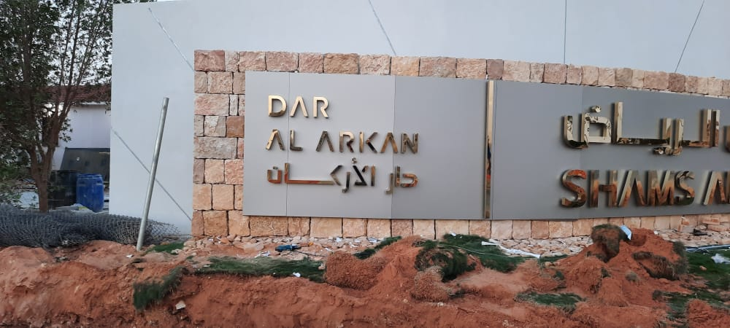

Slide 40
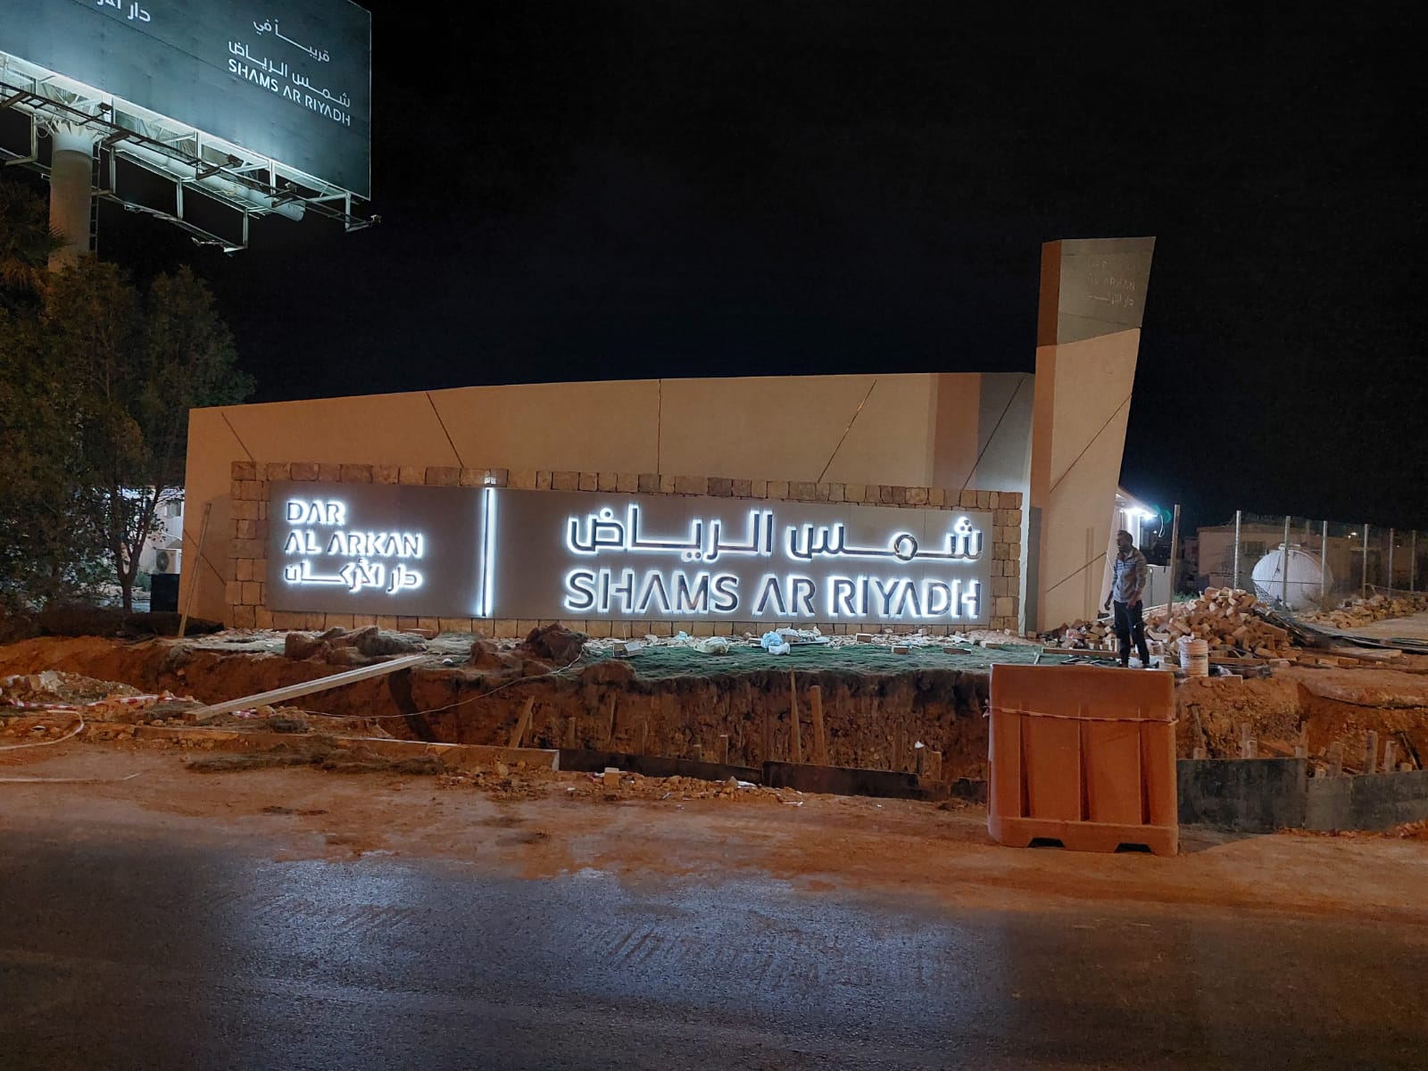

Slide 41
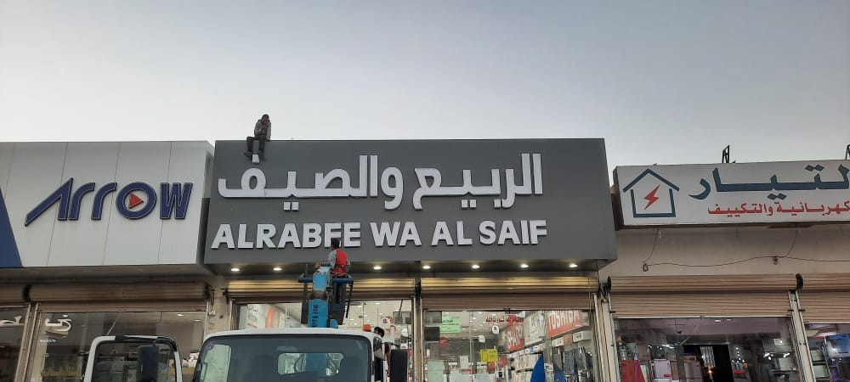

Slide 42
Pylon and Unipol Signage :
Pylon and Unipole Signages are made of steel sectors such as I-beam & H-beam and tubes. They are treated with sandblasting and then insulating paint. They are covered with 4 mm thick cladding panels that are resistant to fire and bad weather factors, with a 20-year warranty against manufacturing defects. .

Slide 45
Cladding Works :
We carry out the external and internal cladding works from the finest internationally approved cladding panels, according to Saudi technical specifications, with a 20-year warranty against manufacturing defects.. .

